Slide 1

Tata – Data Visualization: Empowering Business with Effective Insights
Data analytics approach
Collins Ehigiegba - Data Analyst
Date – 06/11/2023

Slide 2
Agenda
Introduction
Data Exploration
Recommendations

Slide 3
Introduction
Problem Statement:
Present your findings to the CEO and CMO. They are interested in your thought process and how you have handled the data cleanup and visualization phase. It is important to explain your thought process and ideas in a clear and straightforward way. You are also required to clearly present the analysis of all four questions asked by the CEO and CMO.
Our goal:
The goal is to clean, analyze, transform and present an insight answering the four different questions asked by the CEO and CMO in a clear and understanding way. These insights and recommendations will help the company in making proper decisions. The proper strategy to deploy to increase the company growth and revenue in the future while maintaining customer satisfaction.
About Dataset:
Online Retail store provided us with 1 datasets for our analysis and visualization:
Steps Taken:
Data Cleaning → Create a check that the quantity should not be below 1 unit and the Unit price should not be below $0. Cleaned for better quality
Data Transformation → completeness check and new calculated columns of revenue with data type added.
Data Relevancy → What is relevant to both the CEO and CMO respectively?
Data Exploration → Explore the data to reveal insights

Slide 4
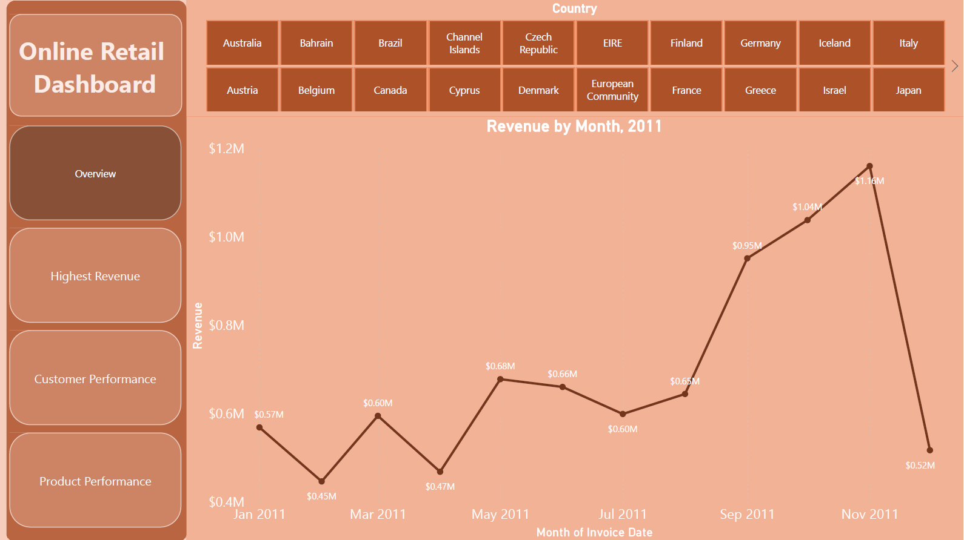
Total Revenue by Month, 2011
Insights:
The first 8 months had stable monthly revenue with an average of $685M
We had a significant increase in revenue from September with the revenue peak at $1.16M in November and an average of 21.17% increase in revenue from August to November.
The revenue trends from August to December demonstrates how seasonality affects retail store sales.

Slide 5
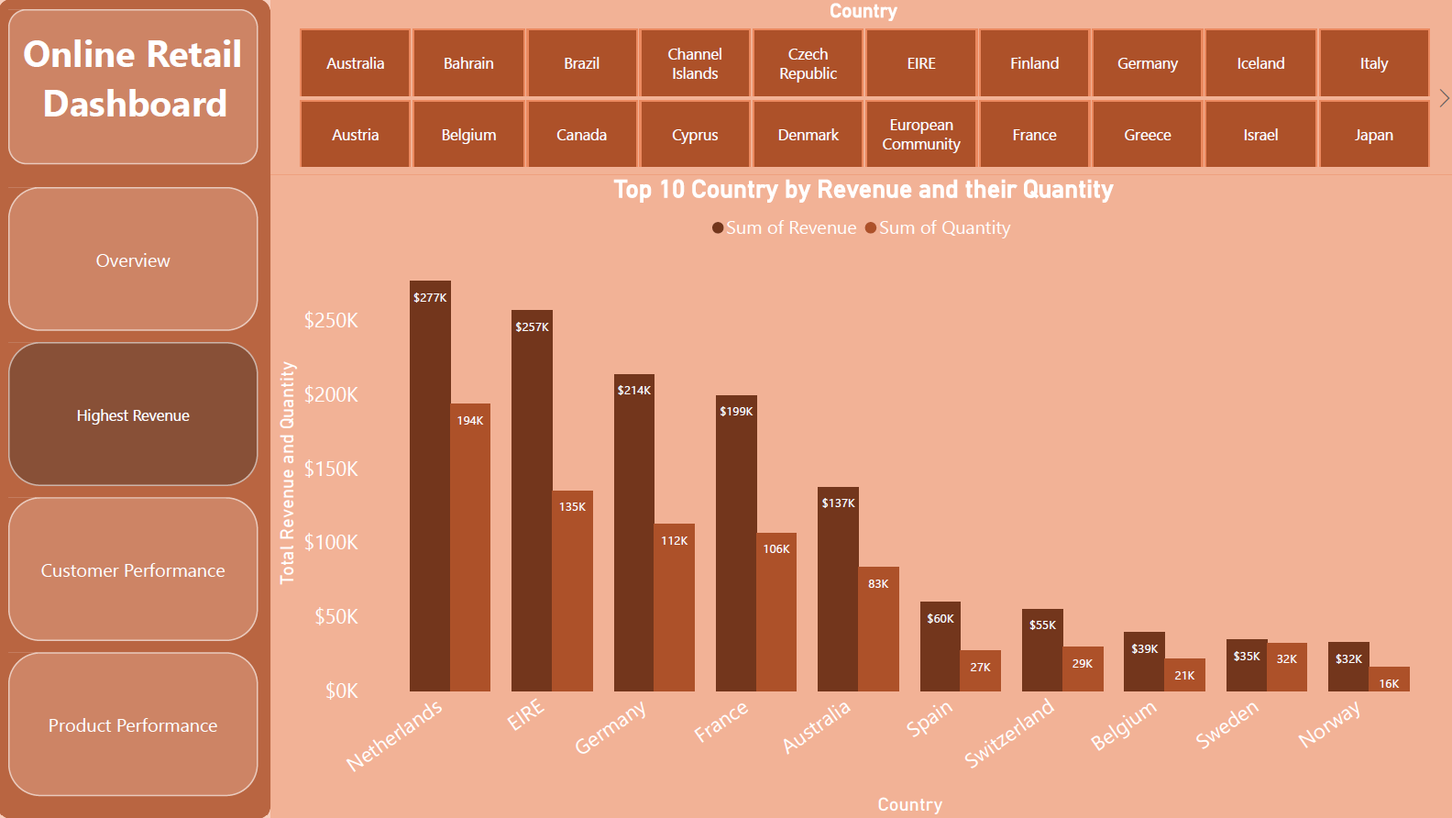
Top 10 Countries by Revenue and their Quantity
Insights:
The charts shows the top 10 countries in revenue and the quantities bought in these countries except The United Kingdom.
There is no major difference between the revenue and the quantity of goods sold in these countries, showing a high purchasing power in these countries.
These countries represent regions with the highest potential to generate more revenue that management needs to focus more on in terms of marketing strategies.

Slide 6
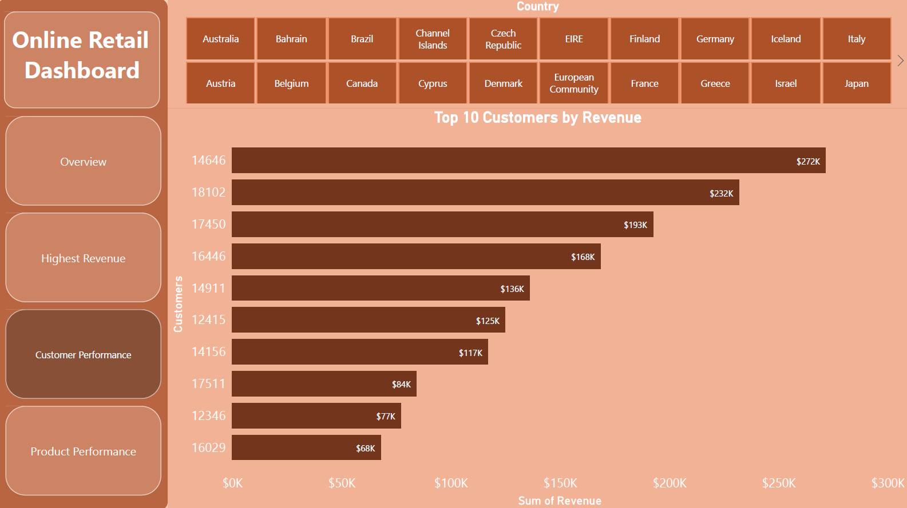
Top 10 Customers by Revenue
Insights:
This chart shows that there is no major difference between the top 10 customers in terms of revenue generated.
The average difference between the top 10 customers is 15.67%.
The company can aim to strengthen the relationship with these customers to increase customer loyalty and retention, and ultimately drive more sales and revenue for the company.

Slide 7
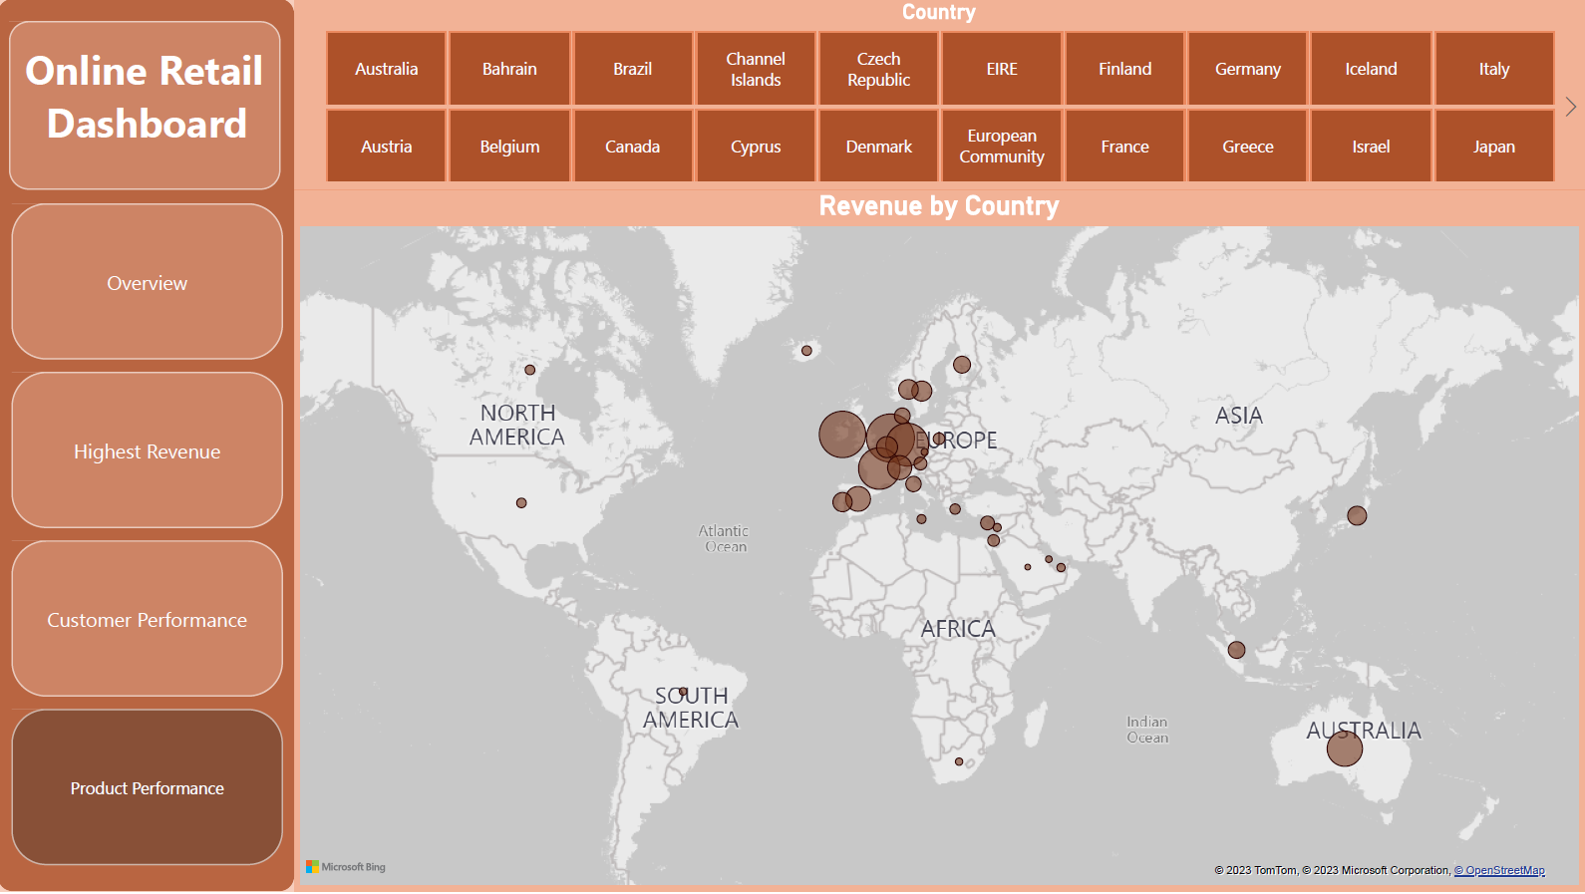
Total Revenue by Country
Insights:
This Map chart shows and compare the country that have produced the highest revenue to those that have not.
The Map also reveals that majority of sales occur in the European region, with only a small number in the American region.
The Map shows that there is no market for the items in Russia, Asia and Africa.
The company can focus more on the European market and dive deeper into countries in the region to come up with strategies that will maximize sales from each country in the region alongside Australia and Japan.

Slide 8
Top Recommendations
The company should do a deeper research and analysis on products that are usually in high demand during low-sales months to come up with strategies for marketing these products.
The company should come up with strategies that aim at stocking and advertising seasonal products to maximize sales when the demand for these goods goes up.
To Strengthen customer relationship with the company, the marketing team should derive a strategy to compensate and incentivizing top revenue generating customers.
The European market has more opportunities for growth and the company should develop more strategies to increase its potentials in the region as well as plans to increase growth rate in other regions.
The company should do a deeper dive into the type of products and the revenue generated from these product in relation to each region. This will help in developing marketing specific for growth in these region.

